Slide 1
ANGULAR CONTROL OF SERVO MOTOR
DESIGNED USING WITH MICROCONTROLLER AND WITHOUT MICROCONTROLLER

Slide 2
ABSTRACT “Creativity is inventing, experimenting, growing, taking risks, breaking rules, making mistakes and having fun.” Quoted by Mary Lou Cook, encouraged us to think on such a topic which can make our lives easier by overcoming the prominent problem faced around the globe. Sometimes we have to make our things automated and there is a need to make the world an easier place to live in. Arduino micro-controller has already made a huge impact on learning. The widespread acceptance gave the open source hardware a new life, potentially challenging many industrial products and new interests in hardware prototyping and electronics. The recent transition has been made from 8 bit to 32 bits and it is expected that in future Arduino may be seen in the form of a cheap practical computer. You can also presently make custom cell phones using open source boards like the Arduino. Looking at this actionable advancement towards Arduino, allured the ideology to make systematic and organized parking system for vehicles, using Arduino Uno. This project's main purpose is to produce a real-life solution to the car parking problem which the whole world is facing frequently. People usually roam around in the parking lots trying to find a suitable place to park in. To solve that problem we have created the automatic car parking system, using open source hardware, programmable sensors and the use of computers to provide an interface to understand the digital output produced.

Slide 3
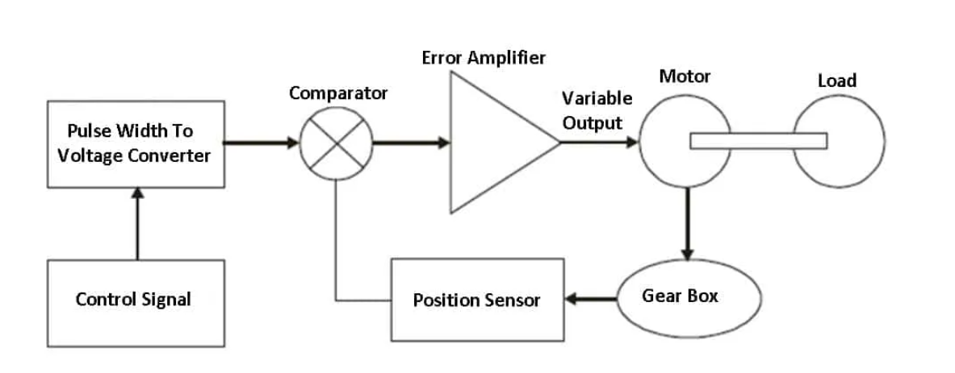
Working of servo motor
A DC servo motor consists of a DC motor, a position sensing device, a gear assembly, and a control circuit. The DC servo motor has a small DC motor is employed for driving the loads at a precise speed and position.
Now, a DC reference voltage is set to the corresponding desired output. This voltage is applied using a potentiometer by controlling the pulse width to the voltage converter or via a timer depending on the control circuitry. The dial on the potentiometer generates a related voltage which is then applied to the error amplifier.

Slide 4
Applications of Servo Motor
Following are the applications of servo motor:
The servo motor is used in robotics to activate movements, giving the arm its precise angle.
These are used to start, move, and stop conveyor belts carrying the product along with many stages. For instance, product labeling, bottling, and packaging.
The servo motor is built into the camera to correct the lens of the camera to improve out-of-focus images.
This motor is used in a robotic vehicle to control the robot wheels, Producing plenty of torque to move, start and stop the vehicle and control its speed.
These are also used in the solar tracking system to correct the angle of the panel so that each solar panel stays to face the sun. In addition, These are also used in metal forming and cutting machines to deliver specific motion control for milling machines.

Slide 5

Code

Slide 6
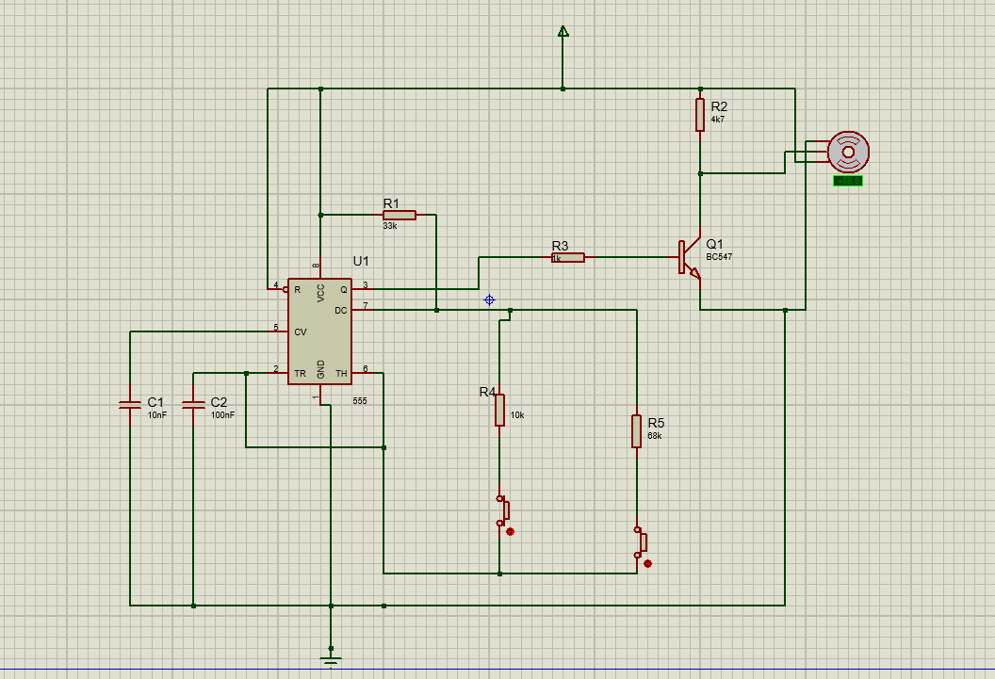
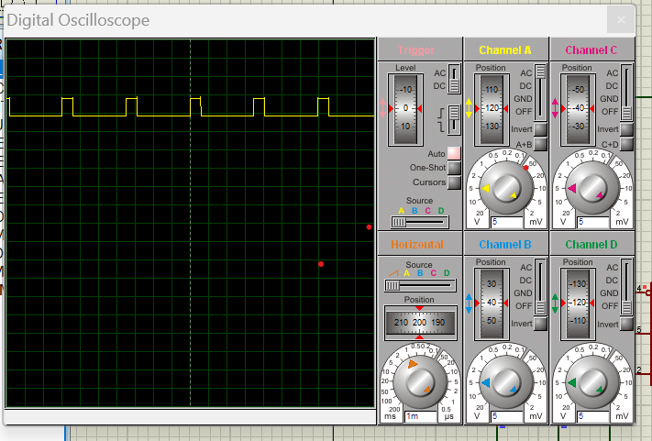
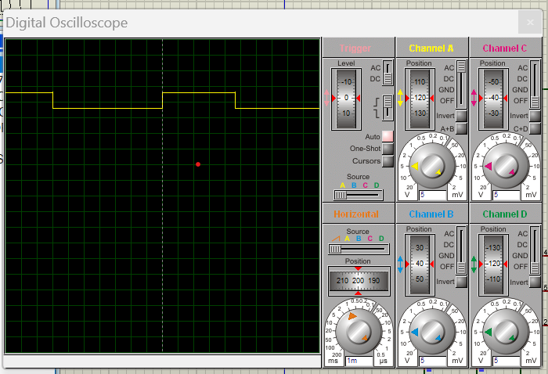
Circuit
input
output

Slide 7
